Slide 1
A Publish/Subscribe System in DT-networks
ZHENG Yuan

Slide 2
Outline
1. Introduction
2. Motivation
3. System Model & Basic Assumptions
4. Pub/Sub framework
5. Challenge Issues

Slide 3
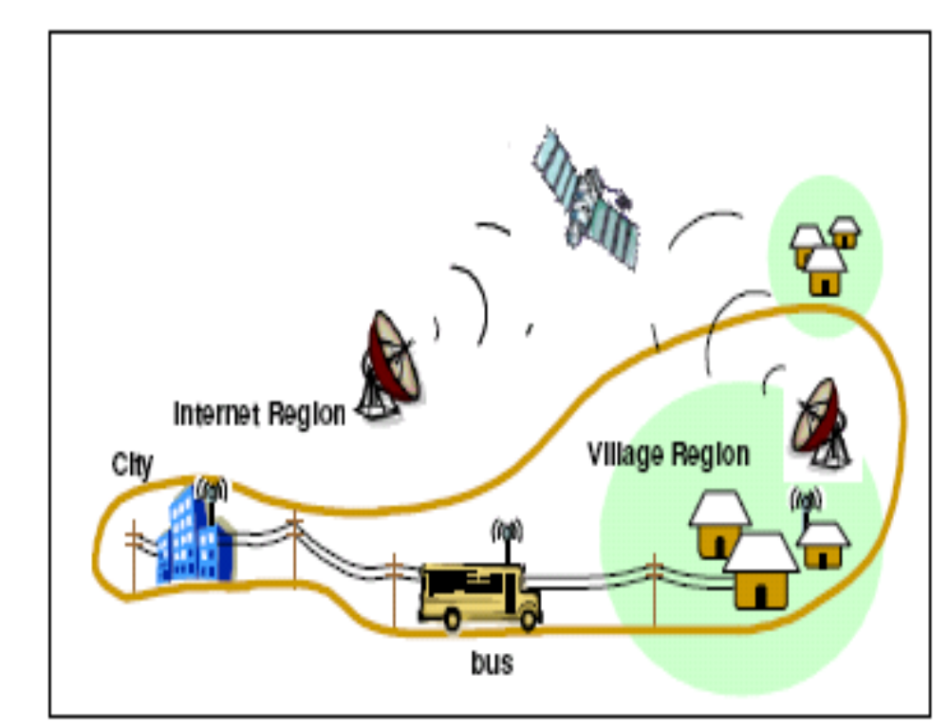
Introduction
Delay-Tolerant Networks
  a kind of regional networks
  carry and forward
Advantages
  overcoming disconnection
  Resource efficiency
  …
Challenges:
  opportunistic contacts
  low reliability
  unexpected delay
  ..

Slide 4
Motivation
Events generation & consumption
Intuitively, Publish/Subscribe Systems are suitable to the applications established on DTNs, if a packet is regarded as an event.
Pub/Sub systems provide a set of programming APIs to facilitate the development of applications on the top of DTNs

Slide 5
Sys. Model & Basic Assum. (I)
A number of sub-networks
  sub-networks are geographically distributed and disconnected with each other.
  every sub-network has one or multiple gateways.
  every sub-network is a connected network.
  the nodes or gateways is aware of their own geographical positions.

Slide 6
Sys. Model & Basic Assum. (II)
Randomly moving nodes
  mobility model: Rand. Walk, Rand. Waypoint, trajectory-based, map-based, etc.
  limited memory capacity
  transmission range: variable
  communicate only with gateways

Slide 7
framework of Pub/Sub Sys.
Broker/Client architecture
  Gateways are brokers
  Other nodes are clients
Events
  identical size
  invalidate after a duration or not ?
  encapsulated in a packet
Mobile nodes
  carry-and-forward

Slide 8
framework of Pub/Sub Sys. (II)
Mobile nodes
  aware or not aware of adv./pub./sub.
  Pull or Push?
Advertisement-driven or Subscription-driven
  The publishers floods adv.
  The subscribers register sub. according to adv.
  The events are delivered according to sub.
Events
  invalidate after a duration or not ?

Slide 9
Challenge Issues (I) (TBD)
Advertisement in DTNs (adv.-driven ?)
  Broadcast ?
  Sub-networks discovery
    who keeps the knowledge of all sub-networks ?
      publishers or
      distributed maintenance of the knowledge
Subscribe in DTNs (sub.-driven ?)
  Subscription registration
    directly subscribe to publisher
    subscribe to gateways of other sub-networks
Publish in DTNs
  Publication dissemination
    end-to-end
    one-to-many
    one-to-whole

Slide 10
Challenge Issues (II) (TBD)
Mobile nodes
  aware of adv./pub./sub. or not
  Pull or Push?
Events
  invalidate after a duration or not ?

Slide 11
Challenge Issues (III) (TBD)
Topology Reconfiguration
  disruption detection & Reconfiguration
    Upstream node initiation
    Downstream node initiation

Slide 12
Challenge Issues (IV) (TBD)
Reliability vs. Efficiency
  Multi-paths (Parallelized)
  Redundancy (Serialized)
    how to re-transmit
  Feedback-based
    Publication lost
    Feedback lost

